Slide 1
Design & Simulation of Half & Full Adders in Logisim
Complete implementation, Boolean algebra derivation, and interactive circuit verification
•

Slide 2

01. Half Adder Design
2-bit fundamental combinational addition and logic gate mapping

Slide 3


Half Adder Logic Fundamentals
Sum Logic (XOR Gate)
Carry Logic (AND Gate)
The Sum output computes the modulo-2 addition of two single-bit inputs (A and B). It produces logic HIGH (1) if exactly one input is 1.
The Carry output handles the arithmetic overflow. It generates a carry HIGH (1) only when both input bits are simultaneously 1.
Configured in Logisim by setting an XOR gate's inputs to 2.
Configured in Logisim by placing a 2-input AND gate in parallel with XOR.

Slide 4
Half Adder Truth Table
Input A | Input B | Carry Out (C) | Sum Output (S) | Arithmetic Result
0 | 0 | 0 | 0 | 0 + 0 = 0 (Base 10: 0)
0 | 1 | 0 | 1 | 0 + 1 = 1 (Base 10: 1)
1 | 0 | 0 | 1 | 1 + 0 = 1 (Base 10: 1)
1 | 1 | 1 | 0 | 1 + 1 = 10 (Base 10: 2)

Slide 5


Logisim Setup: Half Adder
Gate Parameter Reduction: In Logisim, gates default to 5 inputs. Reduce both XOR and AND gates to 2 Number of Inputs.
Pin Assignment: Place 2 input pins labeled A and B on the left, and 2 output pins labeled Sum and Carry on the right.
Wire Routing: Connect pin A to top inputs of both gates; connect pin B to bottom inputs of both gates.
Poke Tool Simulation: Switch to the Poke tool (hand icon) to dynamically click inputs and verify live logic levels.

Slide 6
02. Full Adder Architecture
Cascading two half adders with carry propagation for 3-bit addition

Slide 7
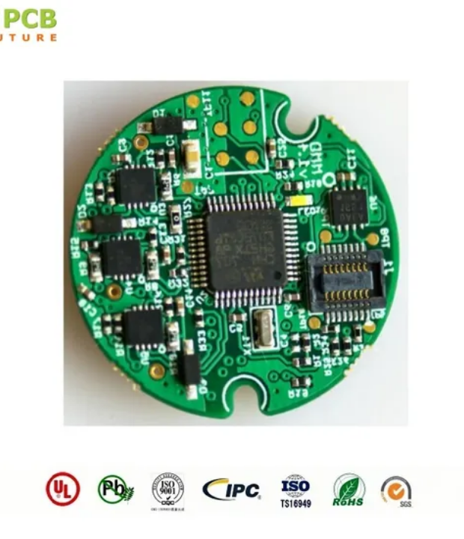
Modular 3-Bit Addition
Overcoming Half Adder Limits
A Half Adder cannot accept an incoming carry bit from a preceding stage, limiting it to single-column additions.
A Full Adder resolves this by incorporating 3 inputs: A, B, and Cin, producing final Sum and Cout using 2 XOR, 2 AND, and 1 OR gate.

Slide 8


Full Adder Boolean Expressions
Full Adder Sum Expression
Carry-Out (Cout) Expression
Computed by chaining the first half adder's XOR output with the third input C (Carry-in):
Generated if either the first stage produces a carry or the second stage produces a carry:
Output evaluates to HIGH whenever an odd number of inputs are 1 (parity check).
The two AND gate outputs feed into a single 2-input OR gate for Cout.

Slide 9
Full Adder Complete Truth Table
A | B | Cin (C) | Carry Out (Cout) | Sum Output (S) | Decimal Addition
0 | 0 | 0 | 0 | 0 | 0 + 0 + 0 = 00₂ (0)
0 | 0 | 1 | 0 | 1 | 0 + 0 + 1 = 01₂ (1)
0 | 1 | 0 | 0 | 1 | 0 + 1 + 0 = 01₂ (1)
0 | 1 | 1 | 1 | 0 | 0 + 1 + 1 = 10₂ (2)
1 | 0 | 0 | 0 | 1 | 1 + 0 + 0 = 01₂ (1)
1 | 0 | 1 | 1 | 0 | 1 + 0 + 1 = 10₂ (2)
1 | 1 | 0 | 1 | 0 | 1 + 1 + 0 = 10₂ (2)
1 | 1 | 1 | 1 | 1 | 1 + 1 + 1 = 11₂ (3)

Slide 10

Full Adder Gate Composition
Modular Circuit Hardware Budget
5
• 2 × XOR Gates: Compute intermediate half-sum and final sum.
• 2 × AND Gates: Calculate stage 1 and stage 2 partial carries.
• 1 × OR Gate: Combines partial carries into final Cout.
Total Logic Gates in Logisim
• Total I/O: 3 Input Pins (A, B, C) and 2 Output Pins (Sum, Carry).

Slide 11




Simulation & Verification Flow
2. Cascade Wiring
Route stage 1 XOR to stage 2 XOR; connect both AND outputs to OR gate.
4. State Verification
Toggle inputs 000 through 111 using Poke Tool to confirm table accuracy.
1. Gate Placement
3. Pin Labeling
Place two XOR, two AND, and one OR gate; set input attributes to 2.
Attach labeled input pins (A, B, C) and output pins (Sum, Carry).

Slide 12
Thank You!
Design & Simulation of Half and Full Adders Successfully Verified in Logisim
Presenter: Toshita
Vinay
Aparna
Sushma
Manasi
•
Roll no-2620030361
2620030387
2620030367
2620030374
2620030380
•
Experiment: 2.1 Complete

